Slide 1

Authority and Obedience
The Milgram Studies and Beyond

Slide 2
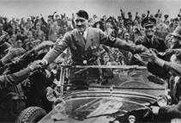
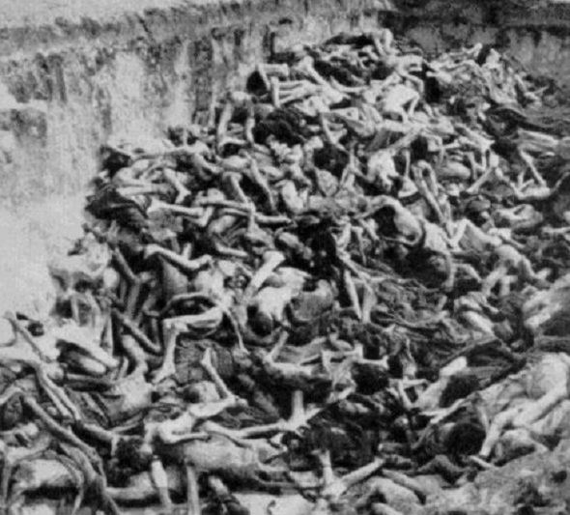
Questions
What are the limits of your willingness to conform to the wishes of people who are in authority?
How sure are you of your limits?

Slide 3
Today’s class
Where authority comes from.
Symbols that evoke a sense of authority and lead to greater compliance.
Milgram Studies and the Zimbardo/Stanford Prison experiment
Factors that affect obedience to authority: Under what conditions do people obey authority to the detriment of (themselves and) others?

Slide 4

Authority
Derived from a “social position”
  Position is conferred by people. It is not related to a physical attribute, like strength.
People with authority have
  The power to punish or reward.
  Access to power and information.
Research focuses on a person’s willingness to conform to the demands of an authority, even if those demands violate the person’s sense of what is right.

Slide 5
Symbols of authority: Titles
Toxic Sludge, Chapter 5
Big Pharma, Part 4

Slide 6


Slide 7


Slide 8
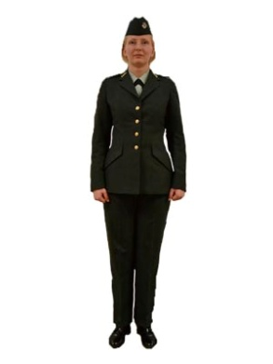
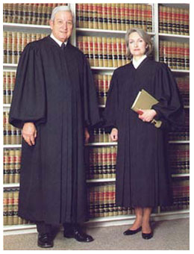
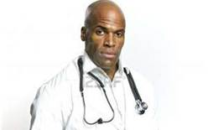
Symbols of authority: Clothes
Uniforms
  Police
  Security guards
  Military
Clothes associated with high-status professions
  Business suits
  Judges’ robes
Clothes associated with certain types of expertise
  Lab coats
  Tweed coats with suede elbow patches

Slide 9
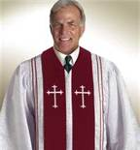
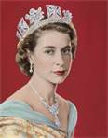

Symbols of authority: Titles
Reverend/Father/Sister or other titles indicating religious authority
Doctor
Professor
Queen/King and other titles indicating royalty

Slide 10
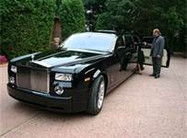

Symbols of authority: Trappings
  Jewelry (or crowns!)
  Cars
  Letterhead stationery
  The corner office
  In our department: An office window

Slide 11

Meet John Gray, PhD
Author of “Men Are from Mars, Women Are from Venus” and 15 other best-selling books
He received a BA and MA in "Creative Intelligence" from the Maharishi International University in Iowa.
John Gray received his PhD from unaccredited Columbia Pacific University after completing a correspondence course in 1982. He was featured prominently in Columbia Pacific's marketing literature in the 1990s prior to its subsequent court-ordered shutdown in 2000.

Slide 12
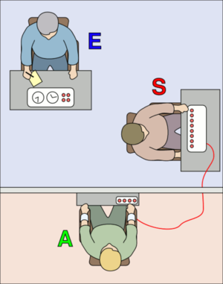
Milgram Studies (1963, 1965, 1974)
Experimenter wore lab coat (symbol of authority) and stressed the importance of the study.
2 participants at a time:
  Learner
  Teacher
Supposed research question: Does punishment increase learning?
Teacher must administer increasing levels of shock every time the learner makes a mistake.

Slide 13
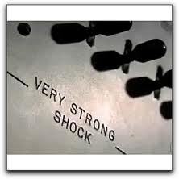
Milgram Studies, cont’d.
Shock levels were from 15-450 volts, labeled in gradations from “Slight Shock” to “Danger: Severe Shock,” to “XXX”.
Milgram shocked the “teacher” (the research subject) with 45 volts so they could see how it felt.
The scientist and the teacher then strapped the learner into the device in a separate room.
The “learner” (an actor) questioned the safety because of his heart condition.
When the learner got questions wrong, the teacher would shock the learner.

Slide 14
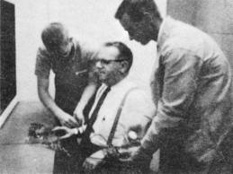
Did people try to stop?
Most people tried to stop.
Researcher told them:
  “Please continue.”
  “Go on.”
  “The experiment requires you to continue.”
  “It is absolutely essential that you continue.”
  “You have no other choice, you must go on.”
The estimate was that between .1% and 3% would obey (estimated by students and by psychiatrists).
The actual results were… shocking.

Slide 15
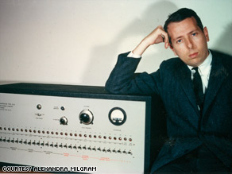
How much shock will people administer before refusing to participate?

Slide 16
Levels at which teachers defected
Voltage | # of Defectors | % | Cumulative %
300 | 5 | 12.5 | 12.5
315 | 4 | 10.0 | 22.5
330 | 2 | 5.0 | 27.5
345 | 1 | 2.5 | 30.0
360-435 | 2 | 5.0 | 35.0
450 | 26 (obedient to the bitter end) | 65.0 | 100.0

Slide 17
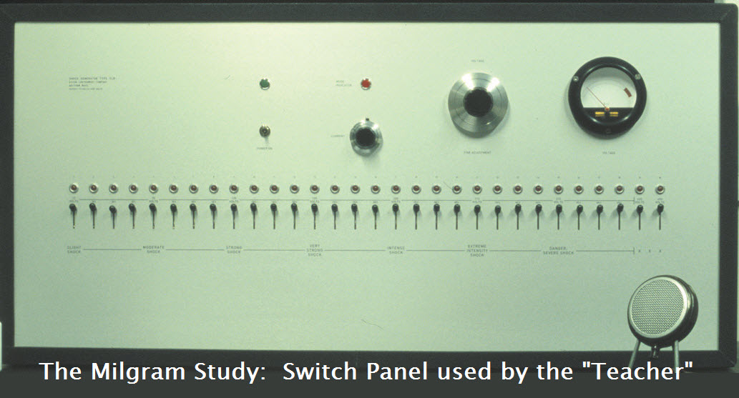
What actually happened…
65% (26 of 40 people) continued to administer increasingly higher voltage of electric shocks all the way to the end of the shock series, despite the fact that the learner had quit responding at 300 volts.

Slide 18
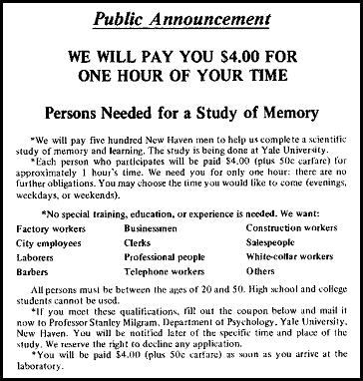
The shocking results
No one quit before the 300 volt mark, the point at which the learner refused to participate any more.
Who were these horrible people?
  Men
  Age: 20 – 50 years old
  20% were professionals
  40% had white collar jobs
  40% were unskilled labor
  Personalities were normal and well-adjusted
  They matched the demographics of the population of New Haven, Connecticut

Slide 19
A modern-day re-enactment
Video
http://www.youtube.com/watch?v=y6GxIuljT3w

Slide 20
Factors that affect obedience to authority
Physical Proximity
  When the learner was in the same room as the teacher, obedience level dropped from 65% to 40%.
Personal Responsibility
  When assured the experimenters were responsible, the “teacher” (research subject) continued.
  Later experiments had research subjects acting as observers and gave them responsibility for outcomes. Under these conditions, they stopped the experiment when the “learner” gave negative reactions to the shock.
Rebellion
  When we see others rebel, we are less likely to go along with authority.

Slide 21
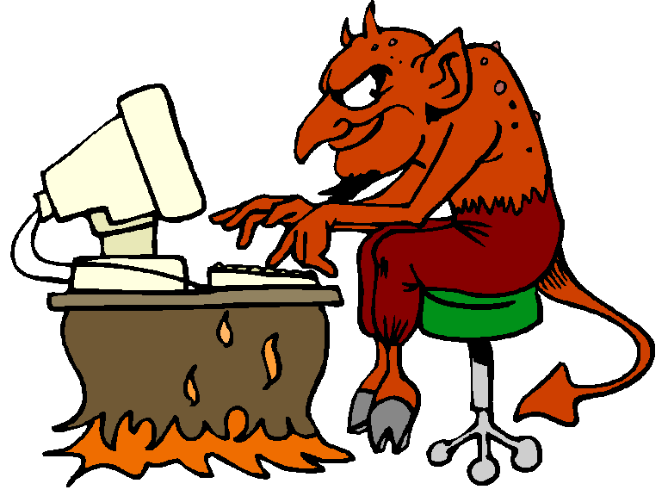
What are the ethics of this type of research?
Subjects had a hard time with the experiment. They were reduced to “twitching, stuttering wrecks.”
  Milgram debriefed them and included a friendly reconciliation meeting between teacher and learner.
  Follow-up survey showed 85% were willing to be future research participants.
Participants were deceived and were led to believe that they injured another person, which may have caused damage to their sense of self.
This type of research can no longer be done in the U.S.

Slide 22
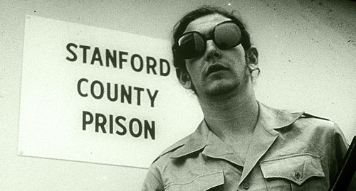
The Zimbardo/Stanford Prison Experiment
Power can be internalized. Symbols and trappings can affect the person who uses them, not just the public or those who are targeted.
Power corrupts. Absolute power corrupts absolutely.
Experiment
http://www.youtube.com/watch?v=760lwYmpXbc&feature=related

Slide 23
Click-Whirr
Our response to authority is highly automatic.
Our early socialization teaches us to respect figures of authority: police, firefighters, teachers, physicians, etc.
Sometimes obedience is automatic, but sometimes we obey because we fear punishment for not obeying.

Slide 24
How can we protect ourselves?
Assess: Is obedience to authority a problem in this case?
Authority is a peripheral cue.
Most of the time it is probably rational to follow leaders and authority figures.
Try to critically evaluate the true expertise and legitimacy of an authority figure.
Question authority when social and organizational change is needed.

